Slide 1
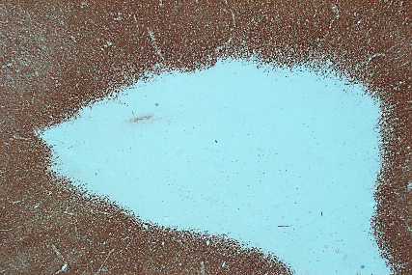
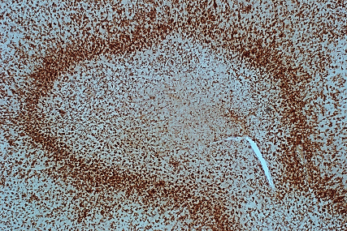
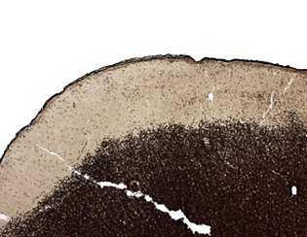
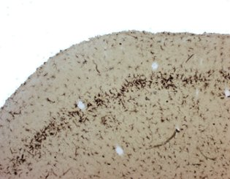
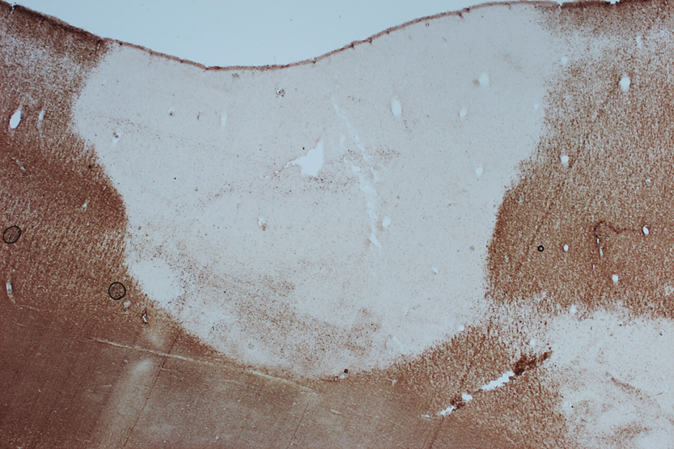
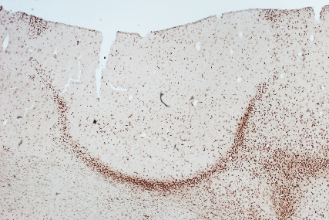
WM Line
GM Line
Type 1
Line
GM
GM
GM
WM
WM
Figure 1 White matter lesions (WML A and B) and Gray matter lesions (GML C and D) were characterized for myelin using antibody against proteolipid protein (PLP) A and C. Microglia/immune cells were characterized using MHC Class II (CII) B and D.

Slide 2
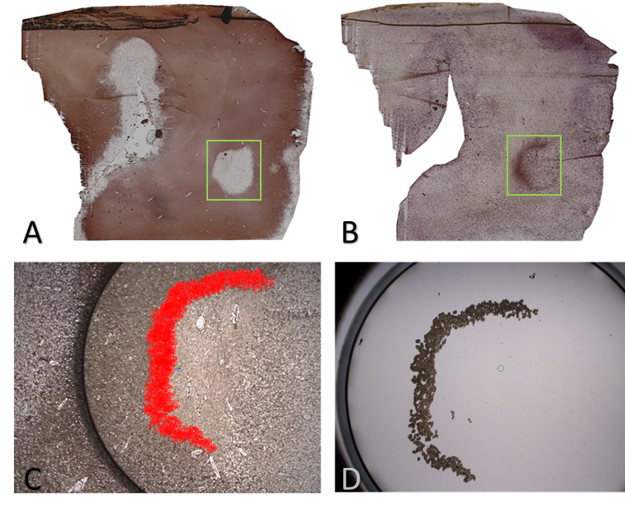
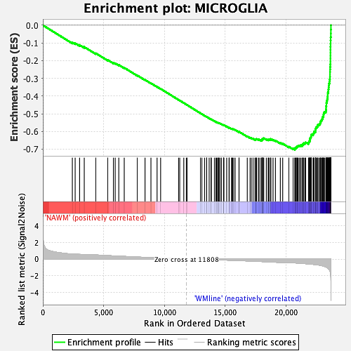
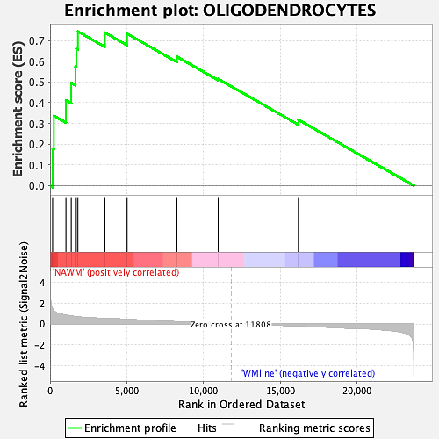
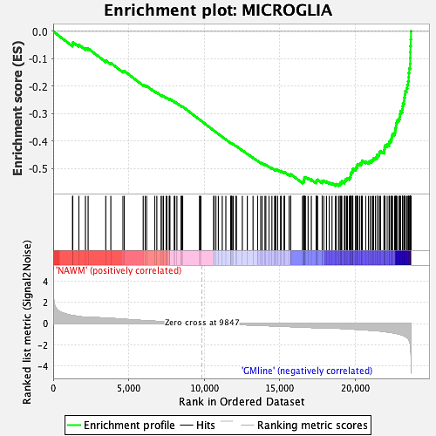
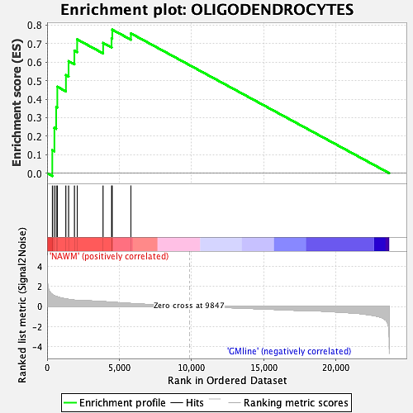
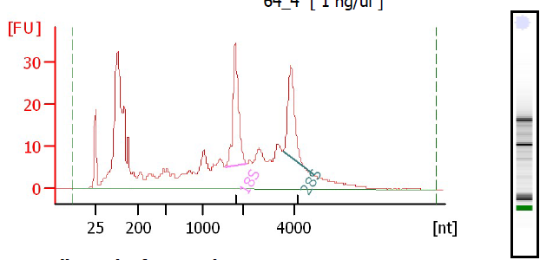
F
P-value = 0.030
NES = 1.50
P-value < 0.001
NES = -2.02
A
B
NAWM
WM line
NAWM
WM line
P-value = 0.048
NES = 1.32
E
P-value < 0.001
NES = -1.64
NAWM
GM line
NAWM
GM line
Figure 2 A. Frozen tissue was characterized with proteolipid protein (PLP) and MHC Class II (CII). Cells (≥4000 per sample) were collected via IR LCM (C), and collected cells (D) were placed in lysis buffer for RNA extraction. RNA integrity number (RIN) was determined using Agilent Bioanalyzer. Only samples with RIN ≥5 were used for RNAseq. Enrichment plots from comparisons of NAWM vs WM line (upper) and NAWM vs GM line (down). F. Microglia-specific genes are enriched in both WM line and GM line by comparison with NAWM bulk RNAseq and Oligodendrocytes-specific genes are enriched in NAWM, but not in WM or GM line samples.

Slide 3
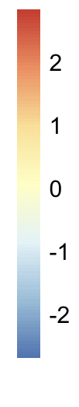
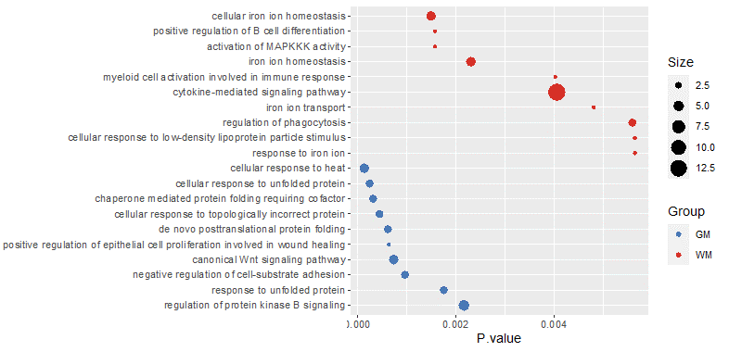

WM Line
GM Line
Fig 1. (A) 176 and 111 genes significantly enriched in WM line and GM line respectively with pval < 0.01 and |log2FC| >1.5 Enriched Gene Ontology Biological Processes Terms (B) and KEGG pathways (C) for each group.

Slide 4
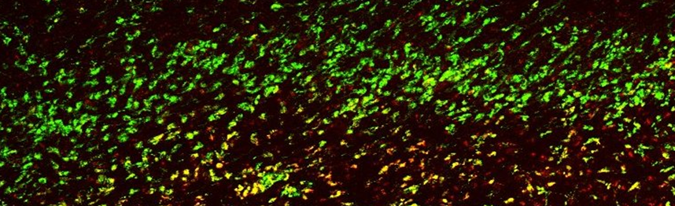
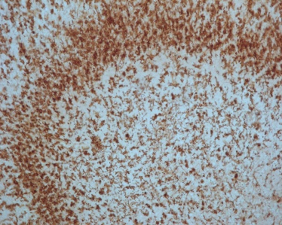
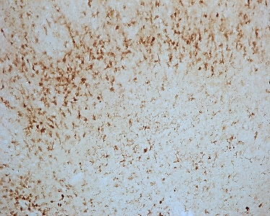
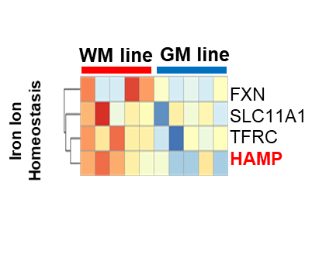
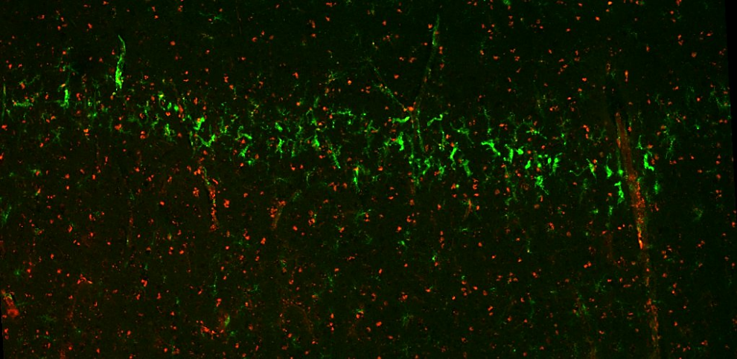
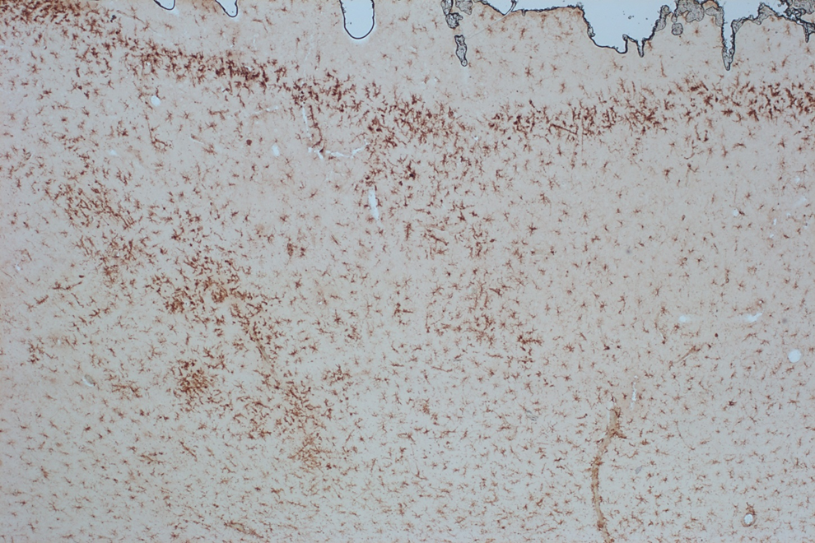
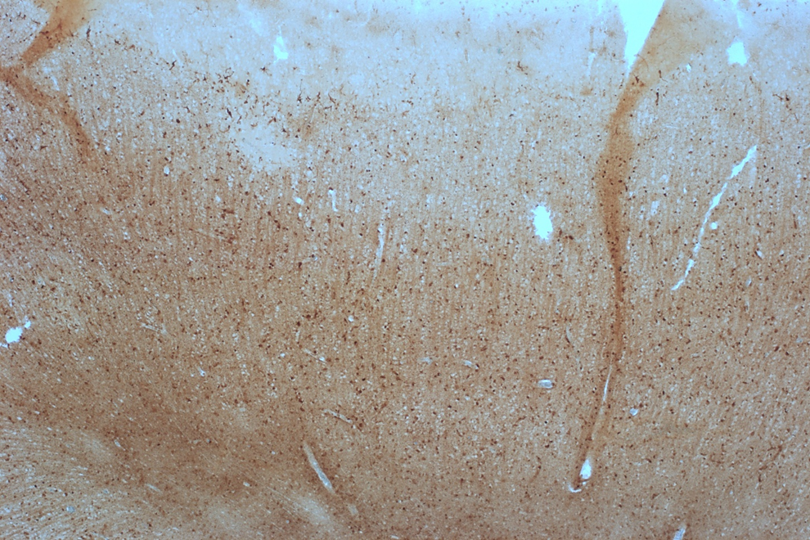
A
D
C
WM Line
WM Line
.
.
CII
Iron
GM Line
GM Line
.
.
CII
Iron
Figure 3 A. Heatmap shows expression profile of significantly altered GO lists in WM line and GM line. B. Immunoflourescent labeling of targets confirms RNAseq data showing increased expression of HAMP and other targets in the iron homeostasis GO list and CSF3R in WM line microglia compared to GM line microglia. C. Staining for total iron in WM line shows microglia positive for iron (arrows) and GM line shows few to no iron positive microglia

Slide 5
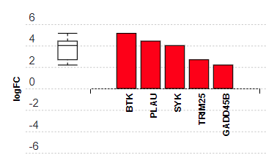
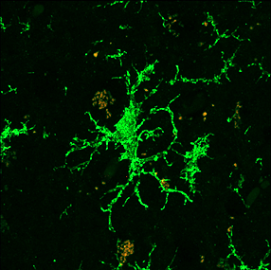
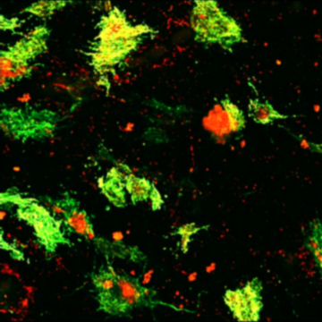
B
C
NF-kappa B signaling
WM
GM
BTK
Figure A Table shows several significantly altered KEGG pathways between WM lines and GM lines. B Expression levels in genes involved in NF-kappa B signaling are significantly increased in WM line compared to GM lines. C Levels of BTK (red) (CII green) are higher in cells at WML border than GML border

